Slide 1
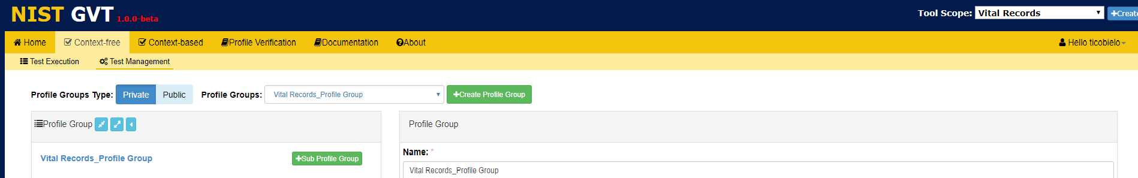
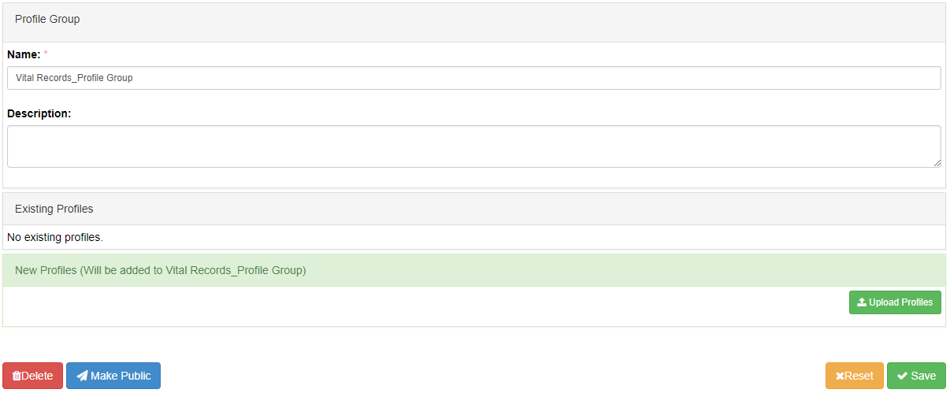
Context-Free Test Management: Uploading Profiles (1)
Click on Test Management in Context-free validation.
Select a Profile Group from the dropdown menu
1
2
The selected Profile Group Info is displayed on the Profile Group window
Click on the Profile Group
3
4
See next slide
Vital_Records_Profile Group Description
Click Upload Profiles
5

Slide 2
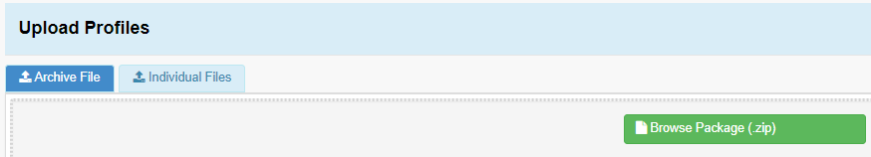
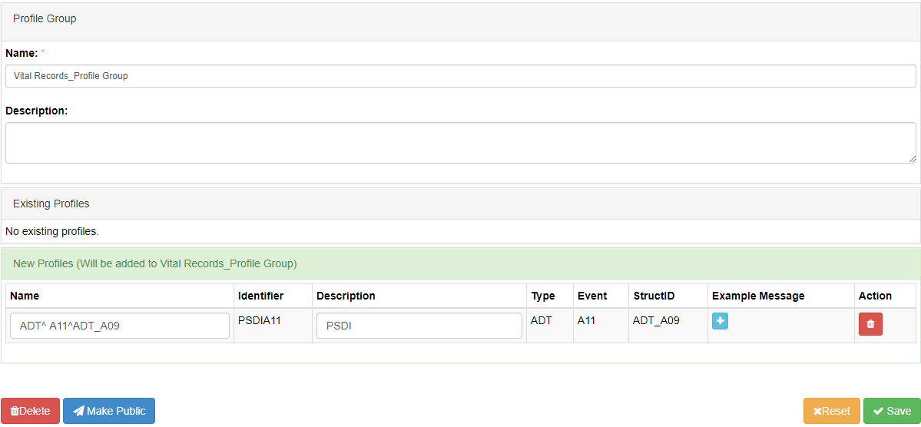
Context-Free Test Management: Uploading Profiles (2)
Upload an Archive or Individual File
Profiles must be created and exported from IGAMT first.
6
The uploaded profiles waiting to be added display in the Existing Profiles panel.
Vital_Records_Profile Group Description
Click √Save
8
7
Notes:
Script: Pre-condition:
Export a profile as zip from IGAMT – the export is save in the download folder
A Tool Scope must be selected first
profile group must be created

